Slide 1


Slide 2


Slide 3
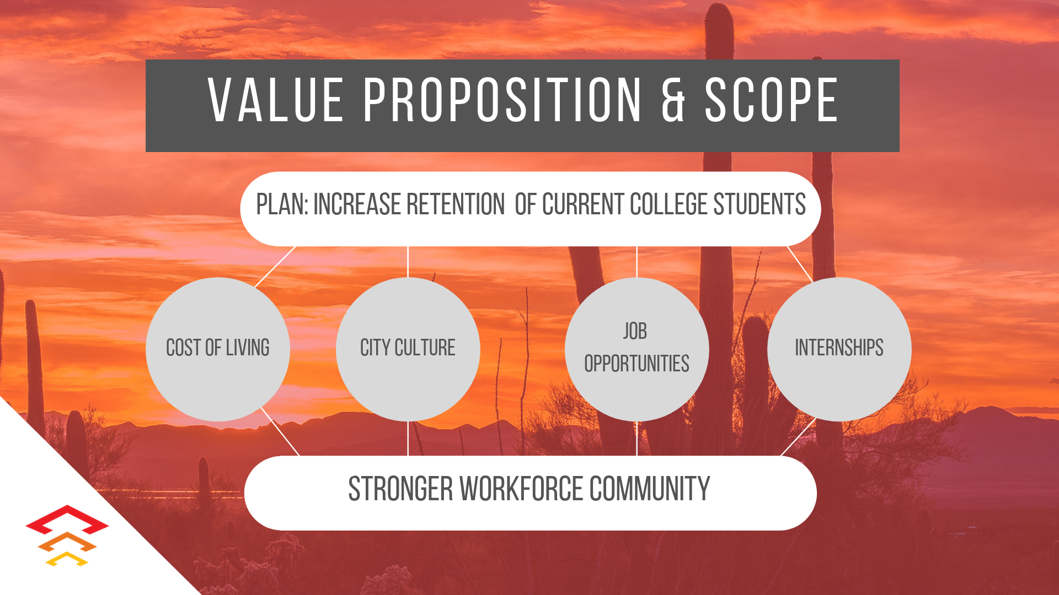

Slide 4
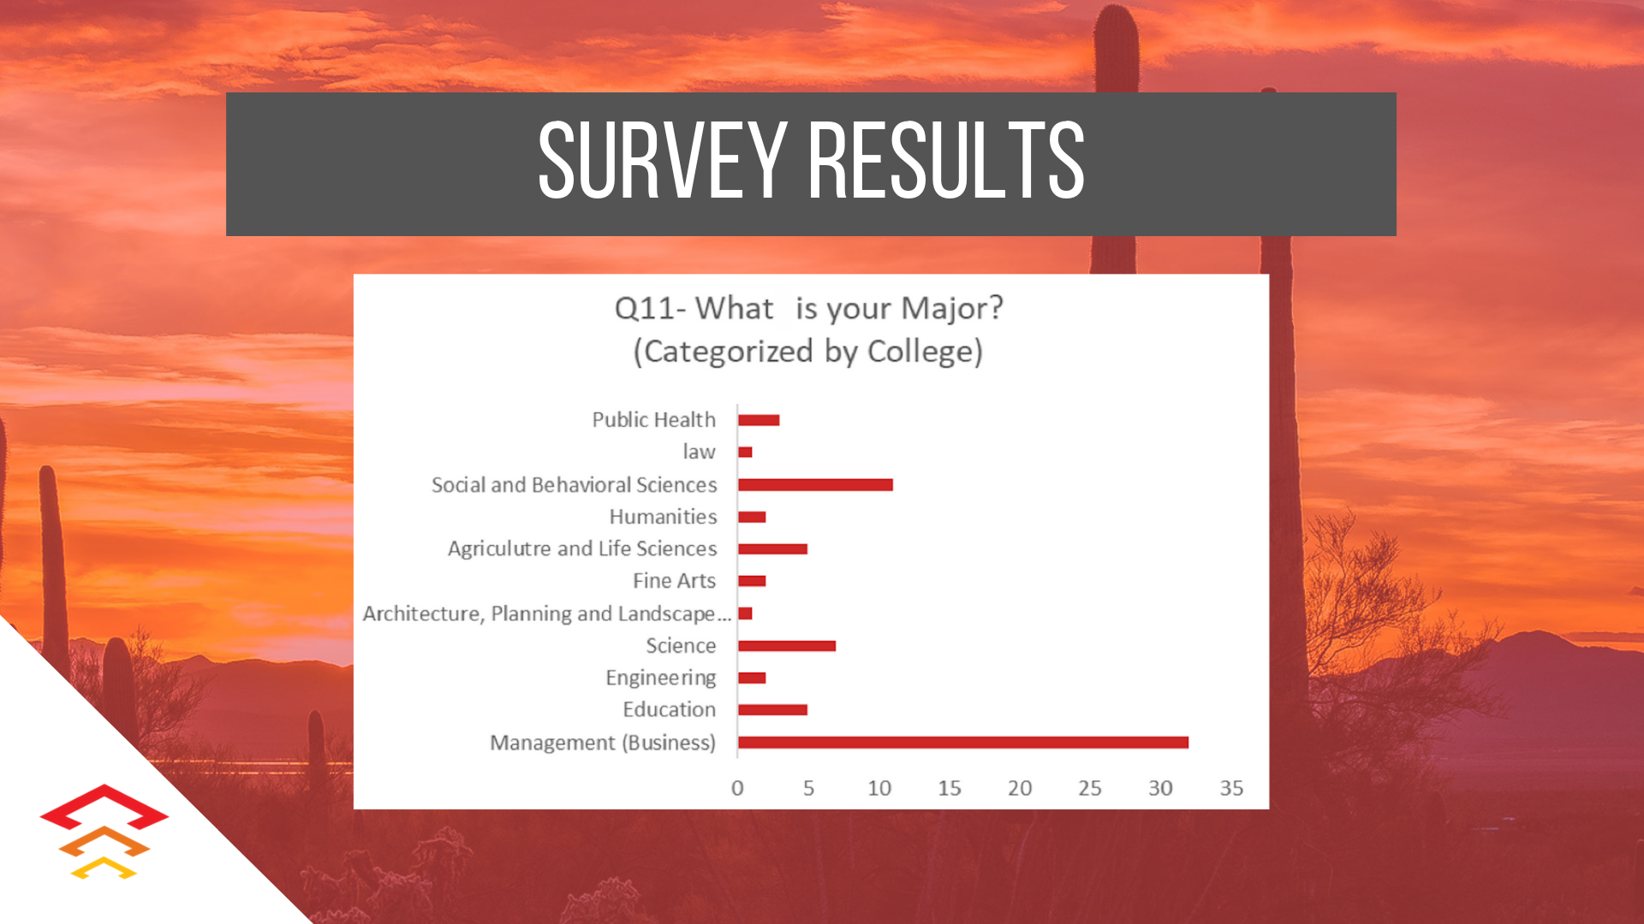

Slide 5
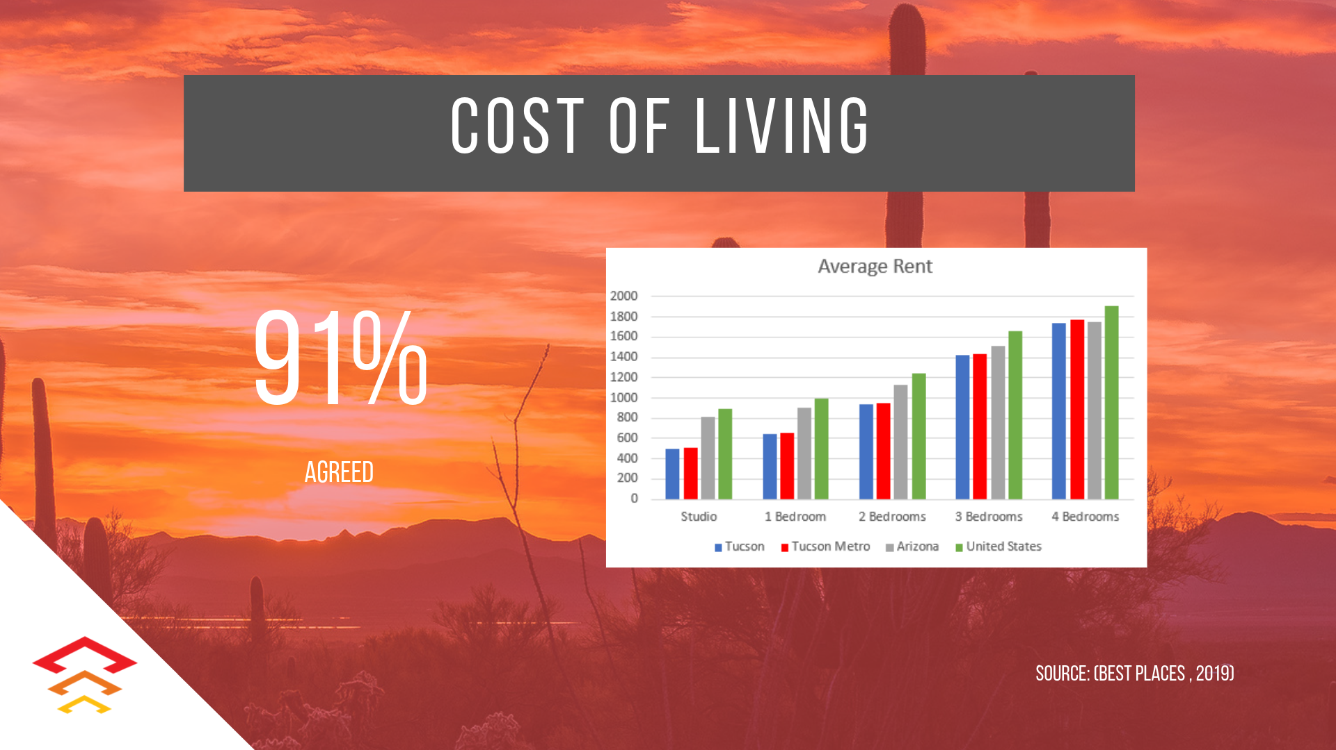

Slide 6
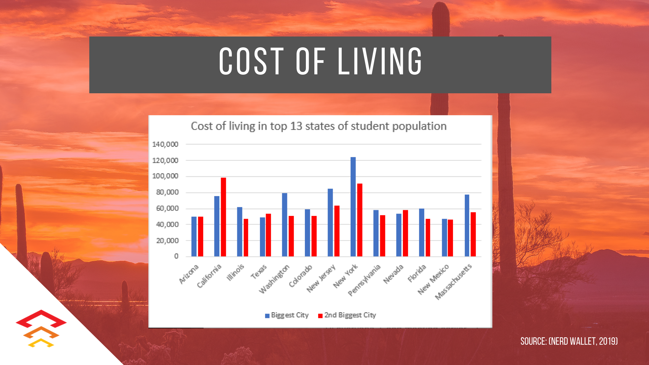

Slide 7


Slide 8


Slide 9


Slide 10


Slide 11


Slide 12


Slide 13


Slide 14


Slide 15
Value Proposition & Scope
Survey Results
Cost of Living (1)
Cost of Living (2)
Millenials Ideal City Culture
Job Opportunities
Internships
Interview Results
Recommendation
Costs
Timeline
Suggested Contacts

Slide 16


